Slide 1
Performance assessment
ROC curve
Area under the ROC curve (AUC)
Examples using ROC
Notes:
Used in machine learning applications to assess classifiers

Slide 2
ROC curves: Simplest case
Consider a diagnostic test for a disease: the expression of a particular gene
Test has 2 possible outcomes:
‘positive’ = suggesting presence of disease
Gene expression is over a threshold
‘negative’
Gene expression is below the threshold
An individual can test either positive or negative for the disease
The selection of the threshold is crucial.

Slide 3
Specific Example
Pts without the disease
Pts with disease
Test Result

Slide 4
Threshold
Call these patients “negative”
Call these patients “positive”
Test Result

Slide 5
Some definitions
Call these patients “negative”
Call these patients “positive”
True Positives
Test Result
without the disease
with the disease

Slide 6
Some definitions
Call these patients “negative”
Call these patients “positive”
Test Result
False Positives
without the disease
with the disease

Slide 7
Some definitions
Call these patients “negative”
Call these patients “positive”
True negatives
Test Result
without the disease
with the disease

Slide 8
Some definitions
Call these patients “negative”
Call these patients “positive”
False negatives
Test Result
without the disease
with the disease

Slide 9
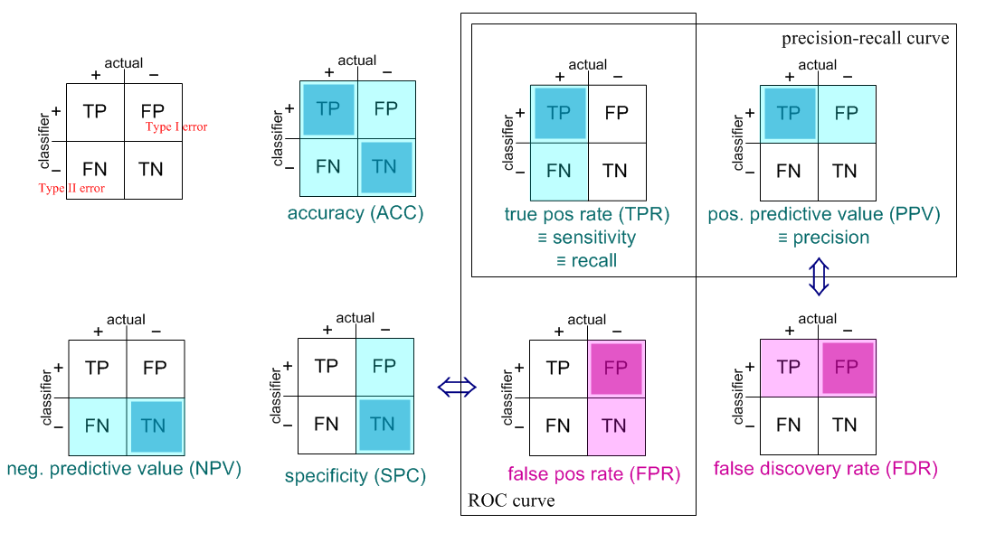
Terminology to measure the performance of classifiers
Different combinations of ratios have been given various names. All vary between 0 and 1. A performance curve picks one as the independent variable and looks at another as the dependent variable.
“one minus”
“one minus”
Dark color is numerator, dark and light color is denominator. Blue parameters: 1 is good. Red: 0 is good.

Slide 10
Many ways to deal with this contingency table
The performance of a classifier is a 2x2 contingency table
the “confusion matrix” of TP, FP, FN, TN
Most classifiers can be varied from “conservative” to “liberal”
Call a larger number of TPs at the expense of also a larger number of FPs
One-parameter curve
ROC plots TPR (y-axis) as a function of FPR (x-axis)

Slide 11
ROC curve
100%
True Positive Rate (sensitivity)
0%
0%
100%
False Positive Rate (1-specificity)

Slide 12
ROC curve extremes
Best Test:
Worst test:
100%
100%
True Positive Rate
True Positive Rate
0%
0%
0%
100%
0%
False Positive Rate
100%
False Positive Rate
The distributions don’t overlap at all
The distributions overlap completely

Slide 13
ROC curve comparison
A good test:
A poor test:
100%
100%
True Positive Rate
True Positive Rate
0%
0%
0%
100%
0%
100%
False Positive Rate
False Positive Rate

Slide 14
AUC for ROC curves
100%
100%
AUC = 100%
True Positive Rate
True Positive Rate
AUC = 50%
0%
0%
0%
False Positive Rate
100%
0%
False Positive Rate
100%
100%
100%
AUC = 90%
True Positive Rate
True Positive Rate
AUC = 65%
0%
False Positive Rate
False Positive Rate
0%
100%
0%
0%
100%

